Slide 1
iCog Makers Robo Soccer Cup
The First Robo Soccer Cup Workshop
Dre Dawa

Slide 2
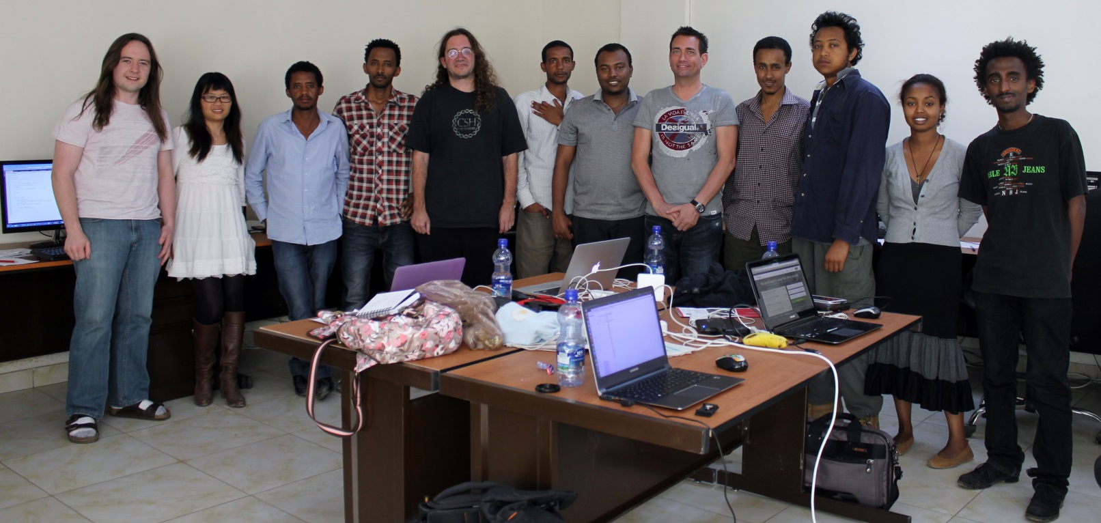

Have you heard about iCog Labs?
iCog-Labs is a team of visionary software professionals, dedicated to advancing the frontier of artificial intelligence research and applications and delivering quality products to customers, based in Addis Ababa, Ethiopia.

Slide 3


Our Partners
OpenCog Foundation: is a non-profit organization, founded in 2011 as a formal entity to foster research. Currently it is building an open-source software project aimed at directly confronting the AGI challenge, using mathematical and biological inspiration and professional software engineering techniques
Hanson Robotics: a private company based in Hong Kong is the leader in creating the most humanlike robots with a full range of human facial expressions. We aim to bring-to-market the most compelling and engaging humanlike robots

Slide 4

What is Humanoid Robot?
Humanoid refers to any being whose body structure resembles that of a human: head, legs, arms, hands. But it is also a robot made to resemble a human both in appearance and behavior.
The difference between a robot and android is only skin-deep, looks exactly like humans on the outside, but with internal mechanics of humanoid robot.

Slide 5


Slide 6
Characteristics of Humanoids
Self-maintenance
Autonomous learning
Avoiding harmful situations to people, property, and itself
Safe interacting with human beings and the environment
Legged locomotion
Arm control and dexterous manipulation
Intelligent System

Slide 7

Sense
Think
Do
Events
Actuators
End-Effector
Manipulators
Machine Intelligence
Environment
What
Where
When
Database

Slide 8
Vision Sensor
Video Sensor Technology
Visual Sensor Network
Navigation Sensor
G-force sensor
Six-axial force sensors
Image Sensor
Inclinometer
Joint-angle sensors
Sensor array
Humanoid Sensors
Sensors
Infrared
Tactile
Proximity
Gyro
Vision
Voice
Pressure
Notes:
An image sensor is a device that converts an optical image to an electric signal
A sensor array is a set of several sensors that an information gathering device uses to gather information (usually directional in nature) that cannot be gathered from a single source
A visual sensor network is a network of smart camera devices capable of processing and fusing images of a scene from a variety of viewpoints into some form more useful than the individual images.eg 3D design of a workplace
A video sensor tech. is a technique of digital image analysis which interprets images using programmable algorithms running on a computer to evaluate scenes (Objects and their characteristics)recorded by a video camera
Tactile Sensors can indicate the presence or shape of an object, its location in the hand, and the force of contact.

Slide 9
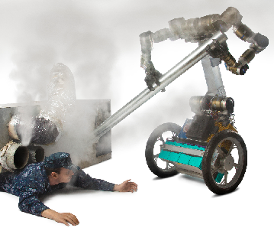
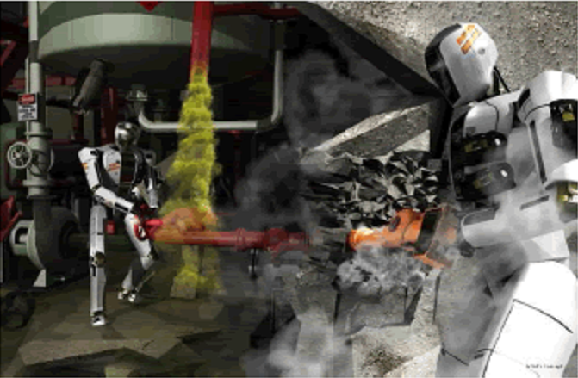
Why develop Humanoid?
They can work in human environment without a need to adapt themselves or to change the environment
It is easier for a human being to interact with a human-like being

Slide 10
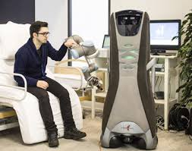
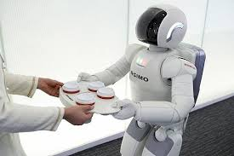
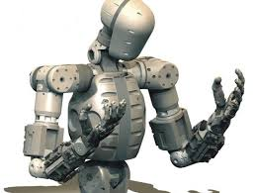
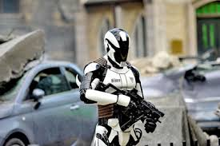
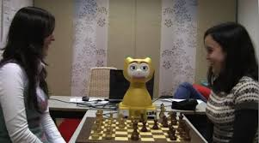
Humanoid Robot Applications
Medical & welfare
Home works
Humanoid
Search & rescue
Entertainment

Slide 11



Social Aspects : Will! You Prefer
A QUESTION for you
Them as a companion
Them as socially accepted?
Will they be able to acquire
some conscience?
Should they evolve ?

Slide 12



Slide 13
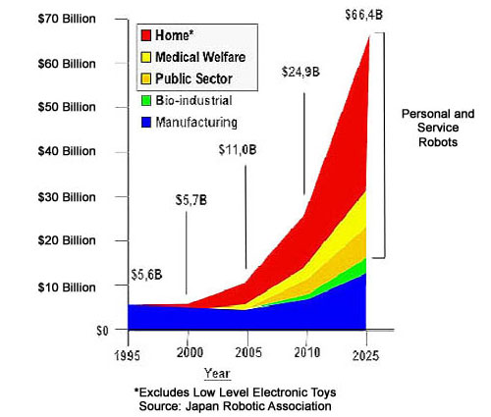
Market and Demand

Slide 14
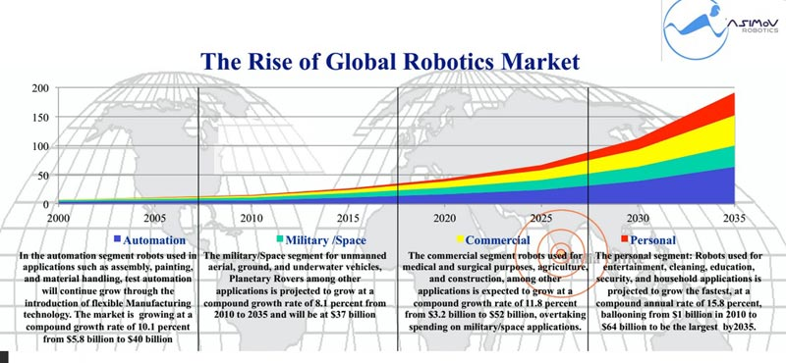
Just after ten years…

Slide 15
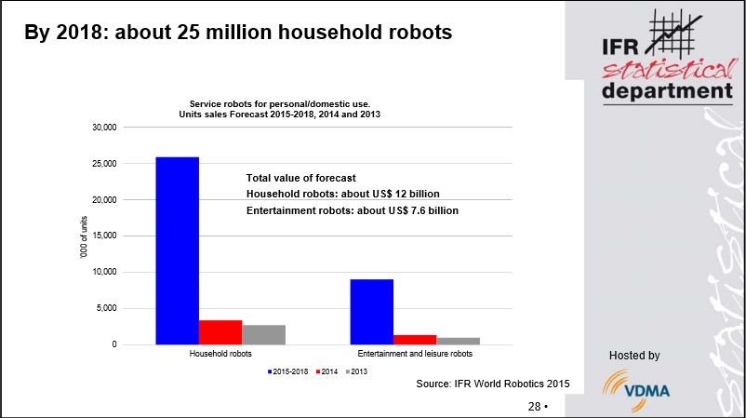
Their Population…

Slide 16

Tune in to the Future

Slide 17
What is The iCog Makers Imitative?
It is a platform for a number of activities aimed at building a future technology community in Ethiopia
It intends to bridge knowledge gaps for Ethiopian students in the fields of AI, Robotics and related filed of sciences.
The Project will establish, mentor and run several Hacker-spaces in Addis Ababa and as well the rest of the country that are publicly accessible places to design and create.
As part of the project, several competitions like Robo-sapien Soccer, Self Driving Cars, and other educational hacking competitions will be organized

Slide 18
What will be the Output of it?
The output of this project envisions producing a large number of revolutionary businesses
Through the competitions, it will help to establish the groups of the Makers community their own startup companies.
It will incubate and accelerate these startups with a global vision.
The Project will also offer classes (short-term training programs on Robotics and AI hosted by iCog Labs and its staff)
It will design and implement a series of programs geared towards capacity building, entrepreneurial education, knowledge distribution

Slide 19
What is the Robo Soccer Competition?
iCog Makers Robo Soccer Cup is a joint project to promote AI, robotics, software engineering and related fields
It is an attempt to foster AI and intelligent robotics research by providing a standard problem where a wide range of technologies can be integrated and examined.
Although the iCog Makers Robo Soccer Cup chose to use the soccer game as a central topic of research, it aims at creating a platform through which the innovations in the process are to be applied for socially significant problems and industries.

Slide 20
Importance of Robot Soccer
Communication
Cooperation
Coordination
Learning
Competence
Real Time
Robot Soccer Evolution
Computer simulations
Wheeled brainless robots
Wheeled autonomous robots
Legged autonomous robots

Slide 21
Robot Soccer Purpose
“The number one goal of robot soccer is not winning or losing, but accumulating diverse technology.”
- Mr. Dao (Senior VP of Sony Corporation).

Slide 22
Robot Soccer?
Robot Soccer competitions proposed to help collaborate and evaluate various approaches:
Software, hardware, electronics, sensors, motors, theories.
Difficult problem, challenge for top universities and industries

Slide 23
Integrating Various Technologies
Autonomous Agents
Collaboration of agents
Strategy Acquisition
Real-time Information Processing
Mobile Robotics and Robot Vision
Hardware and Software Technologies

Slide 24
Options for a soccer playing robot
For now, we had two options
1)Build one from scratch
2)Use existing robots
If from scratch | If to use existing humanoids
It gives you more room to be creative | It gives you the freedom to focus more on the soft ware
The educational value is priceless | It saves you time
Limited to the capacity of the existing labs | It will give you a room to understand the question of how to hack existing humanoids and gives you an insight on the concept of reverse engineering.
Consumes time | Less educational value regarding the designing and the mechanical engineering parts

Slide 25
Footballer Humanoids on the market
1. DARwIn-OP (ROBOTIS OP)
2. DARwIn Mini (ROBOTIS Mini)
3. NAO Evolution
4. Romeo
5. HUBO 2 Plus
6. HOVIS Series Robots
7. RoboThespian
8. HRP-4
9. ASIMO
10. iCub

Slide 26

EZrobot

Slide 27

Meccanoid G15Ks

Slide 28
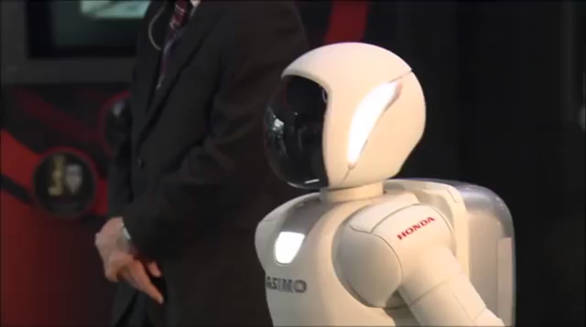
Obama Vs Asimo

Slide 29
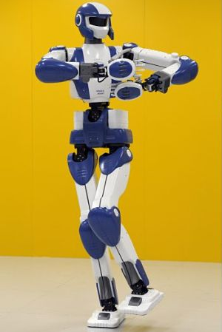
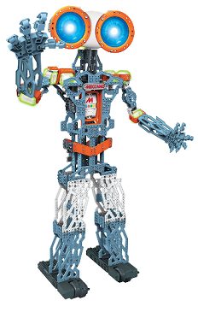
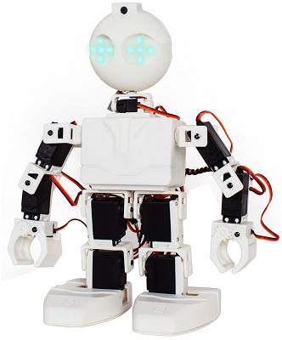
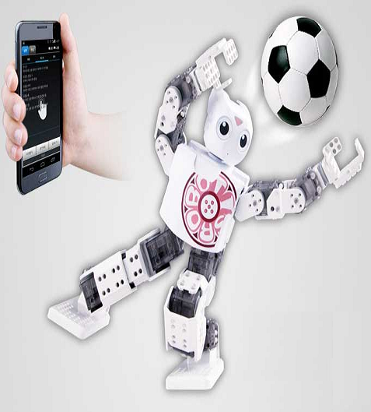
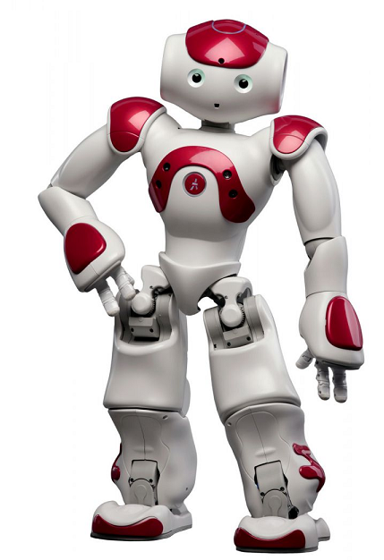
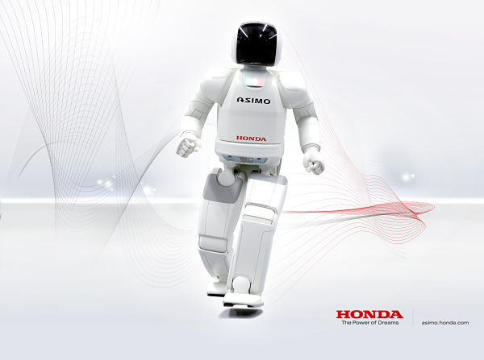
But why can’t we use this?
These Robots are costly and we cannot afford them!
300 400 430 499 7,500 2.5m
HRP-4 G15Ks EZ DARwIn Nao Asimo

Slide 30
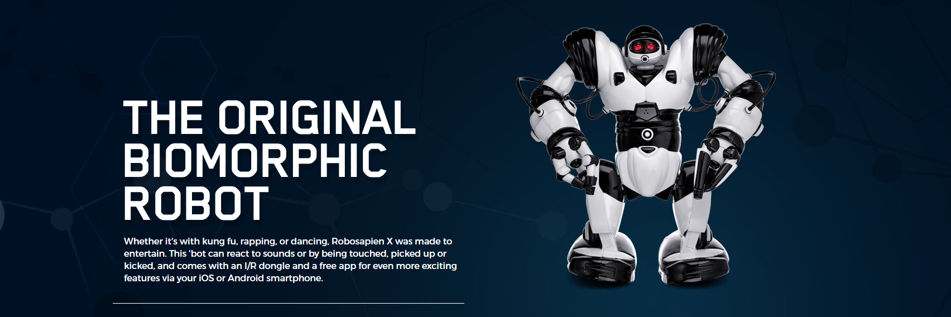
iCog’s Alternative

Slide 31
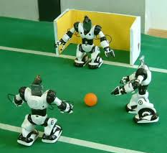
The former Robosoccer cup Champion
Designed to be hacked
Had been tested as footballer
Affordable from 75-100 USD
Comes with more than 60 commands

